Slide 1
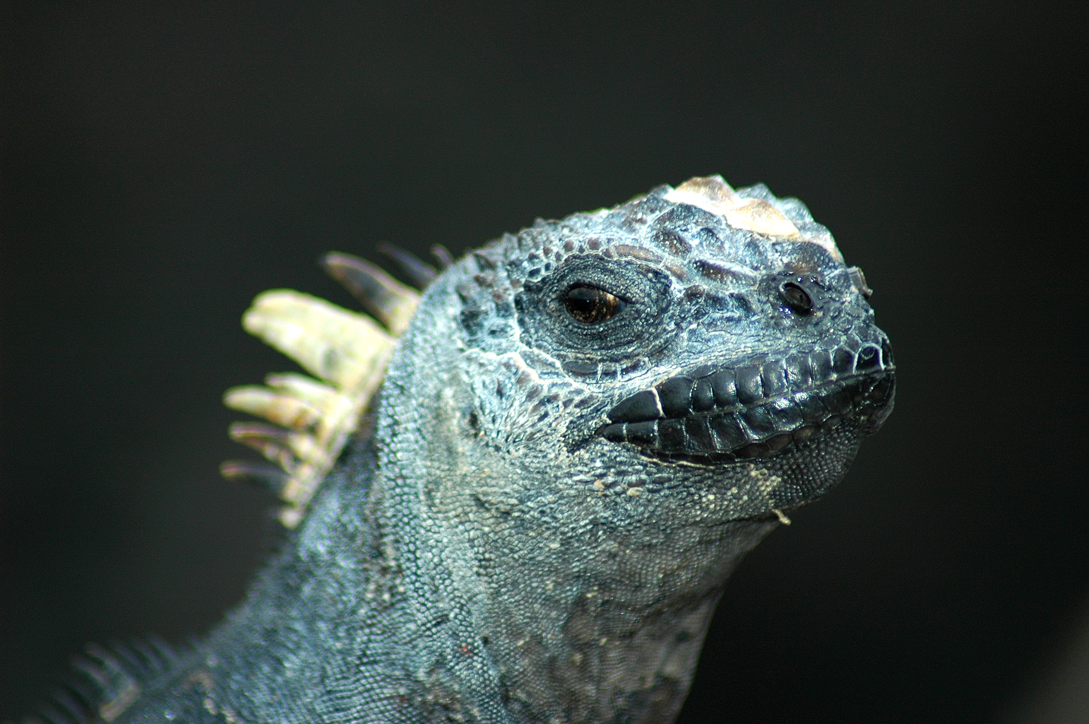
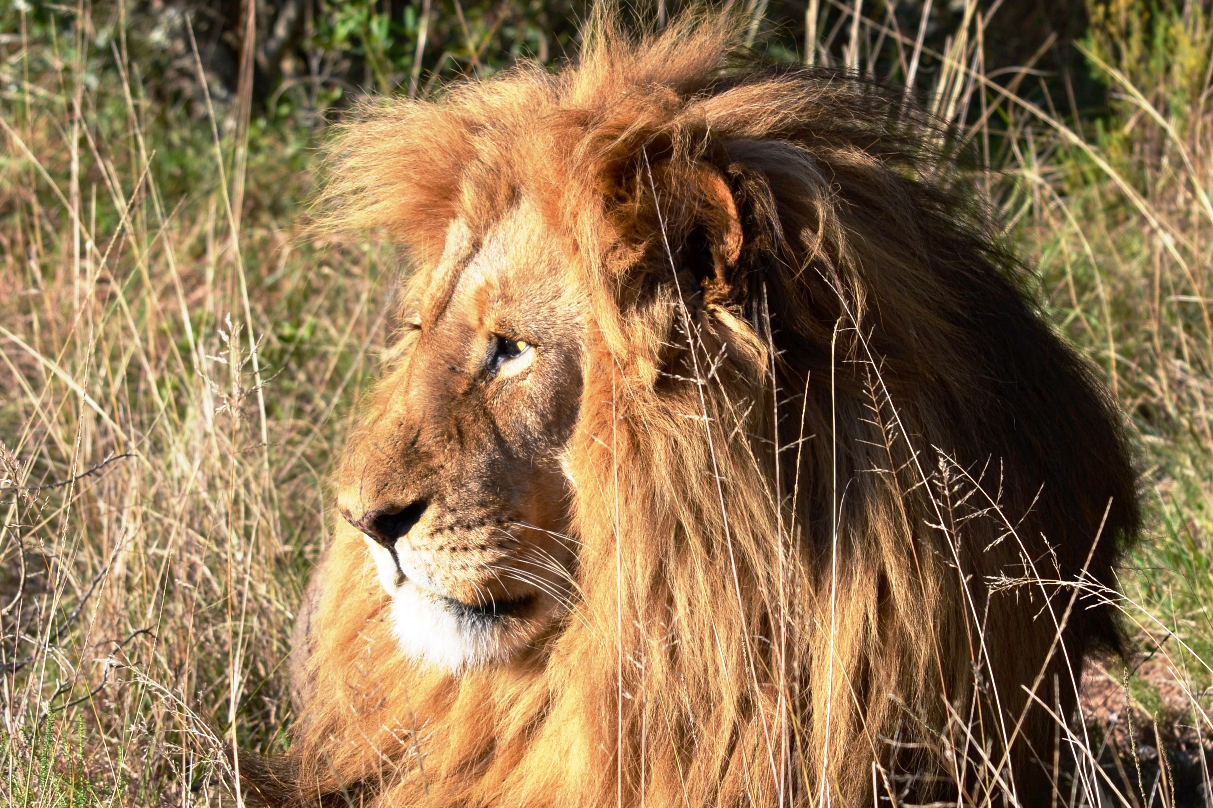
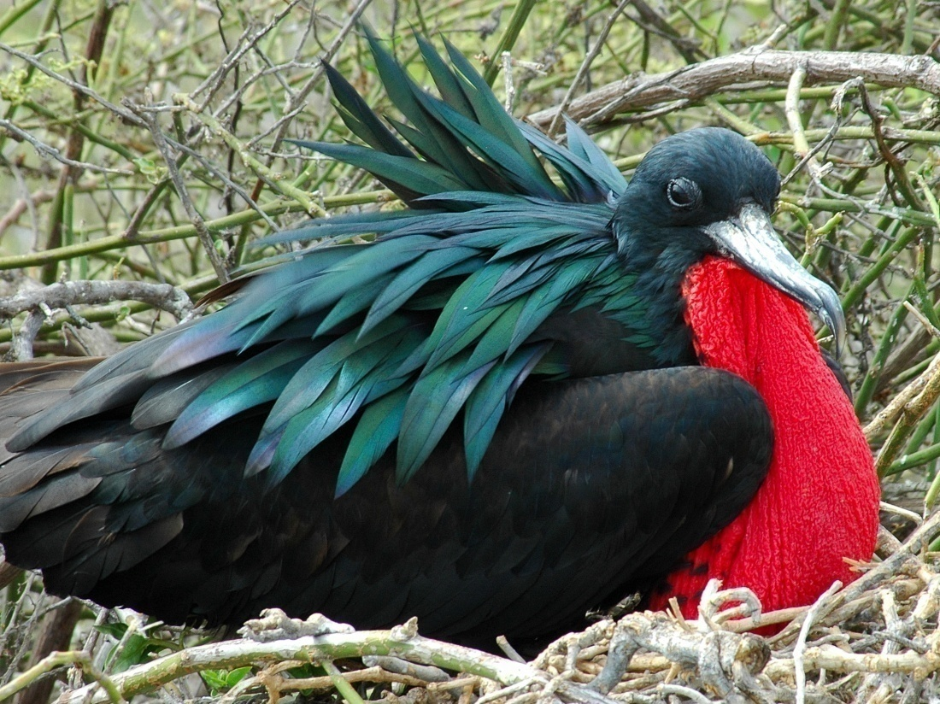
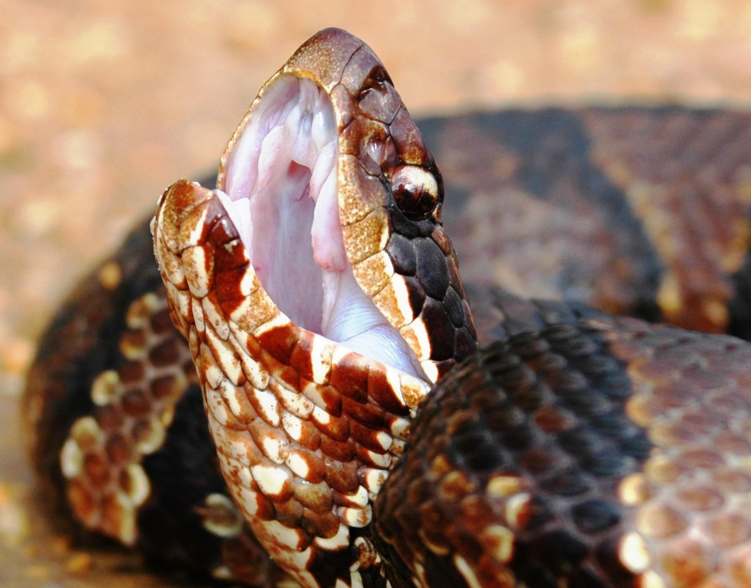
Unit 1: The Nature of Zoology
A brief introduction to the concepts that make
zoology what it is.
© Ken Hackman
© Ken Hackman
© Ken Hackman
© Ken Hackman

Slide 2
I. Fundamental Properties of Life

Slide 3
1. Chemical Uniqueness
Living systems exhibit a unique and complex molecular structure
No matter how much we are alike, we are so very much different from one another.

Slide 4
2. Complexity and Hierarchical Organization
Atoms
Macromolecules
Cells
Tissues
Organs
Systems
Organisms
Populations
Communities
Ecosystems
Biomes
Biosphere

Slide 5
In the Biological Hierarchy, there are certain properties that emerge at a given level of the hierarchy, which we call emergent properties.

Slide 6
3. Reproduction
Do you remember “All living things reproduce”?
Now, ask yourself , “How?”
Is everything the same?

Slide 7
3. Reproduction (cont.)
Heredity
You are what your parents are!
Variation
Fortunately, there are other sources and you can get a wide variety of traits from all of the previous generations!

Slide 8
4. Possession of a Genetic Code
DNA and the sequencing of the nucleic acids that make it up create a genetic code. This controls the framework by which all life is/was created! SAME proteins – different sequences!

Slide 9
5. Metabolism
All of the chemical activities of the body make up the METABOLISM of an organism.

Slide 10
6. Development
This involves CHANGE,
not GROWTH
Significant change AFTER EMBRYONIC DEVELOPMENT results in what we call METAMORPHOSIS

Slide 11
7. Environmental Interaction
The study of how organisms interact with their environment is called ECOLOGY.

Slide 12
II. Life Obeys Physical Laws
The First Law of Thermodynamics
(The Law of Conservation of Energy – Energy can neither be created nor destroyed- only changed in form.)
B. The Second Law of Thermodynamics
(Also known as the Law of Entropy – all living systems are moving toward a greater state of decay, disarray, or death.)

Slide 13
Question?
III. Zoology as a part of Biology
What is an animal and why are there so many different types?

Slide 14
A. Zoology - Zoon (animal) Logos (study)
Cytology- study of cellular structure
Types of Cells
Prokaryotic Cells (before + nucleus)
Lack a nucleus; genetic material in center of cell
Bacteria and cyanobacteria
1st cell type to evolve
Eukaryotic Cells (true + nucleus)
DNA bound by a nuclear membrane
Contain membranous organelles
Animals, Plants, Fungi, Protists

Slide 15
B. ANIMALS vs. PLANTS
A. Usually free-living A. Usually sessile
B. Consumers B. Producers
C. No photosynthesis C. Photosynthesis
D. Respond quickly D. Respond slowly
E. No central water vacuole E. Large central water vacuole
F. No rigid cell wall F. Rigid cell wall (cellulose)

Slide 16
C. Therefore, animals are:
Mobile
Eukaryotic
Multicellular
Heterotrophs*
*ONLY animals ingest food (eat)

Slide 17
IV. Principles of Science – Controversy of Church and State
Arkansas tries to initiate teaching of
Creationism rather than Evolution.
B. ACLU files suit
C. Arkansas decides to teach both
D. ACLU files suit again

Slide 18
IV. Principles of Science (cont.)
1982 – Judge William Overton
1. Science is guided by natural law
2. Science is explanatory by reference to
natural law
3. Science is testable against the
observable world
4. Science is tentative, its results are
never final!
5. Science is falsifiable

Slide 19
V. Scientific Method: A new name !
As there are many scientific methods of doing things, SOME
Higher-level books are learning a new term for this which you should be aware of: Hypothetico-deductive method.
Control – The part of an experiment where NOTHING changes, to have a group to reference against.
Independent Variable – What is being tested
Dependent Variable – anything that happens as a result of the Independent Variable.
Powerful theories that guide extensive research are called
PARADIGMS.

Slide 20
That’s All Folks!

